Slide 1
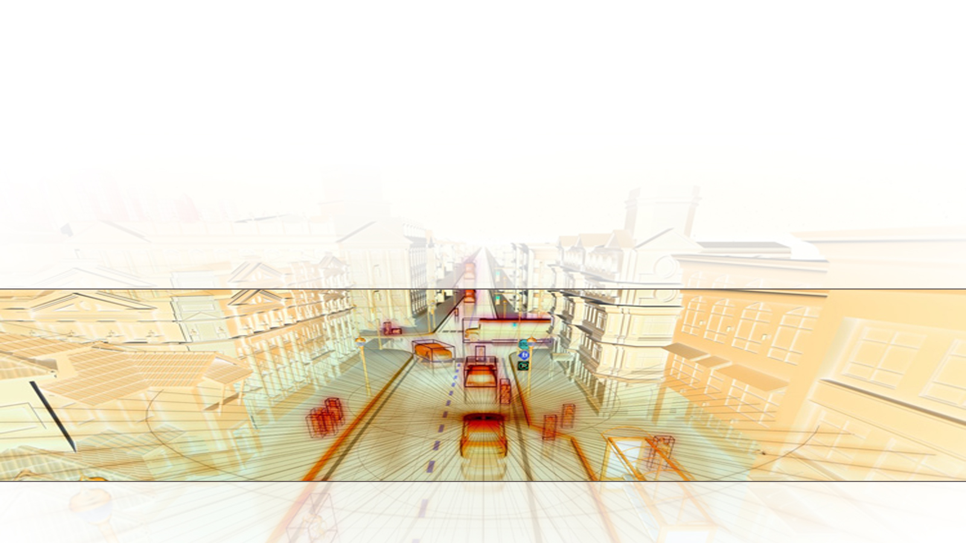

Implement Online Simultaneous Localization And Mapping (SLAM)
with Lidar Scans in MATLAB
Professors: J. Cacace & F. Ruggiero
Student: Arash Hashemi (P44000038)

Slide 2

Outline
Background Knowledge
What has been done?
Implementation in MATLAB
Results
1/18

Slide 3

Background Knowledge
Localization: Estimating the position of the robot
Mapping: Draw a map representing the environment
Environment’s map could help finding the position.
Position could help to map the environment.
SLAM: Simultaneous Localization and mapping can improve
our estimates of positioning and mapping.
2/18

Slide 4
Background Knowledge
SLAM algorithms are of two types:
Offline:
Full SLAM to map the environment using a batch of data (Several consecutive measurements) using smoothing techniques.
online:
Real-time SLAM using filtering techniques such as Kalman Filter and Particle Filter. Continuously building and updating the map.
3/18

Slide 5
Background Knowledge
How to measure Position:
Odometry-based:
Using wheel encoders
Velocity-based:
Using IMU
How to observe the environment:
Lidar:
Estimates the distance of an object from sensor
4/18

Slide 6
Background Knowledge
What is Pose Graph?
A graph made by nodes (Estimated position), edges (Trajectory between two position, or constraint), and the environment
Closure loop:
If two observations are the same or similar, the algorithm consider them the same region and marks a closed loop
What is Pose Graph Optimization?
Compensation for errors in mapping and positioning when observing a previously visited environment using closure loop
5/18

Slide 7
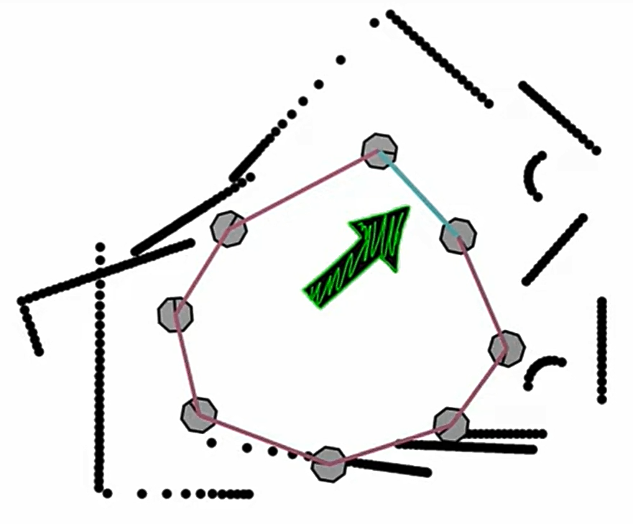
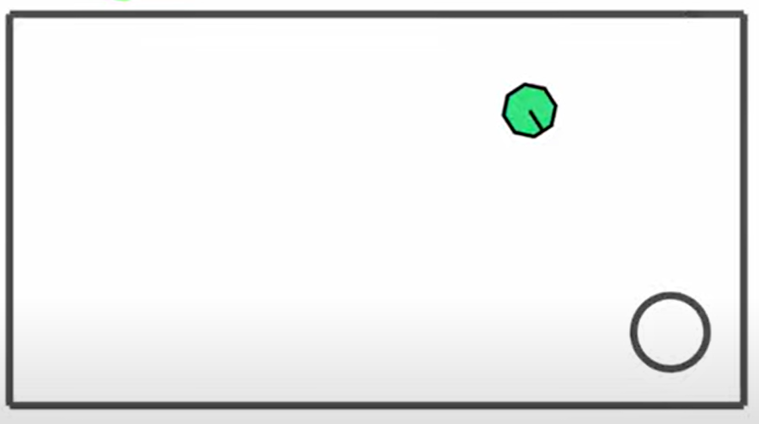
Background Knowledge
Pose Graph Optimization (Source: https://www.youtube.com/watch?v=saVZtgPyyJQ)
Similar Observation
In two different positions
Real map
Several Observations
6/18

Slide 8
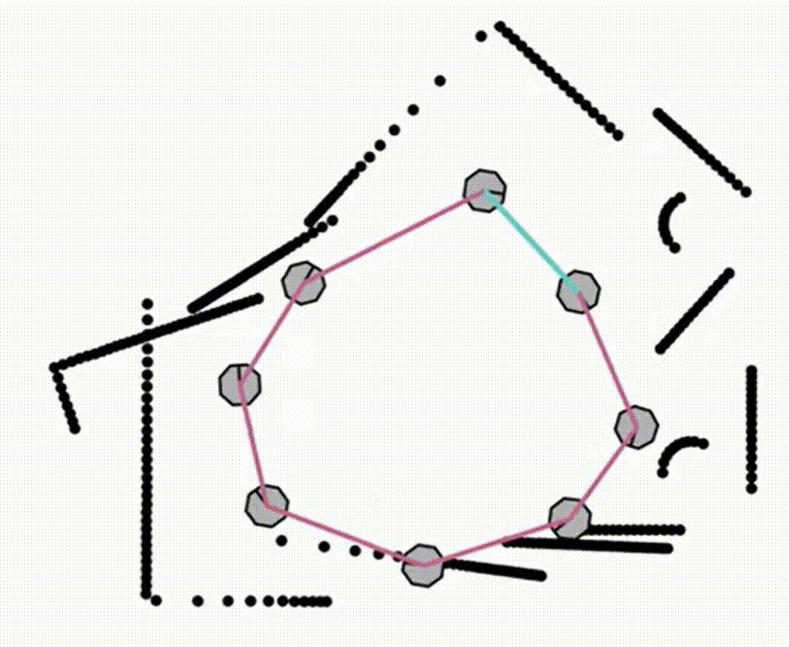
Background Knowledge
Pose Graph Optimization (Source: https://www.youtube.com/watch?v=saVZtgPyyJQ)
7/18

Slide 9

What has been done?
Implement online SLAM using lidar scans
Lidar
Robot’s Positions
Map (+Occupancy grid map)
Robot’s
Trajectory
SLAM
Simulink® 3D
Animation™
8/18

Slide 10

Implementation in MATLAB
Some changes in the example code:
Using own robot trajectory to have a more complex path
Visualization of more loop closure
Showing all steps that a loop closure is present
The aim of the code:
Visualizing the motion of the robot
Performing SLAM
Visualizing the mapping and optimization in steps
Obtaining occupancy grid map
9/18

Slide 11
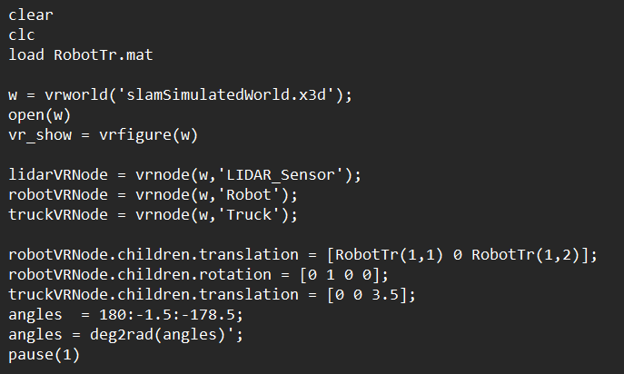
Implementation in MATLAB
Importing, declaring, and modifying the trajectory, environment, and objects
Virtual reality world
Objects defining
Objects modification
10/18

Slide 12
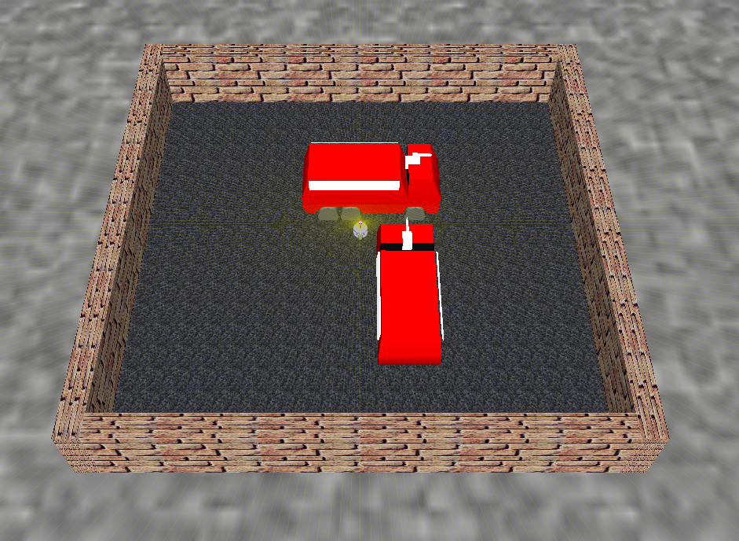
Implementation in MATLAB
Virtual code window
11/18

Slide 13
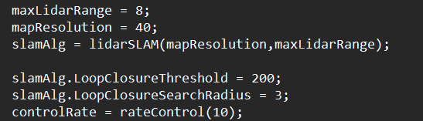
Implementation in MATLAB
Defining the SLAM object and its setup
Maximum Lidar Range is 10 meter by default. Due to the noise in long distance observations, it is set to 8 meter
Resolution, threshold and radius of loop closure can change the resulting map.
12/18

Slide 14
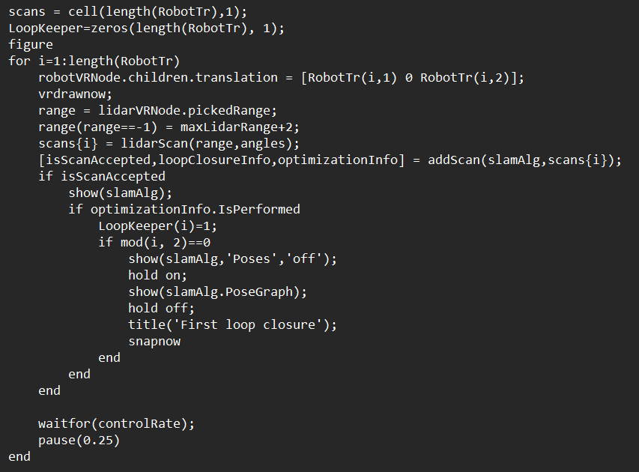
Implementation in MATLAB
Performing loop
Robot Motion and Lidar scan
Verifying scan data
Mapping visualization
Loop Closure visualization
Optimization visualization
13/18

Slide 15
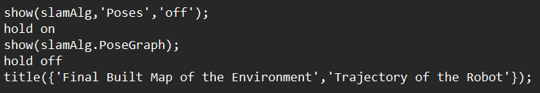
Implementation in MATLAB
Showing results
Printing all steps that there is a loop closure
Plotting the resulting pose and map
14/18

Slide 16
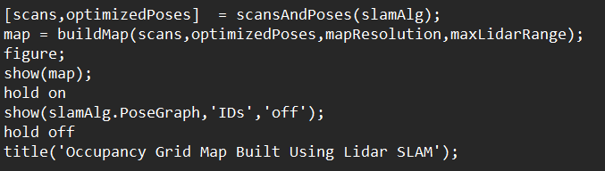
Implementation in MATLAB
Occupancy grid map
Occupancy grid map is to set binary values for free and occupied cells, and 0.5 for unknowns.
15/18

Slide 17

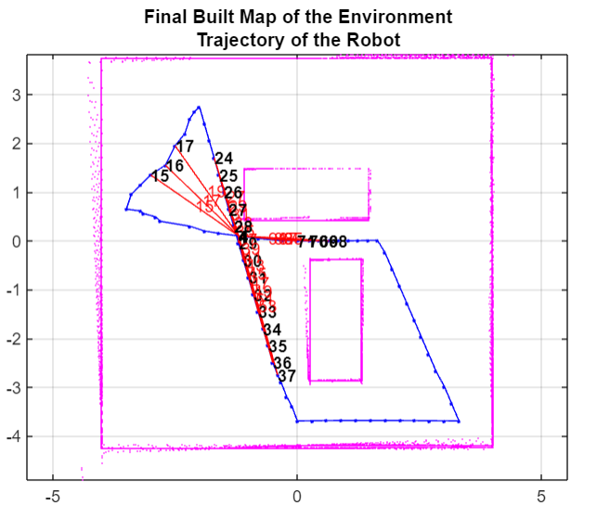
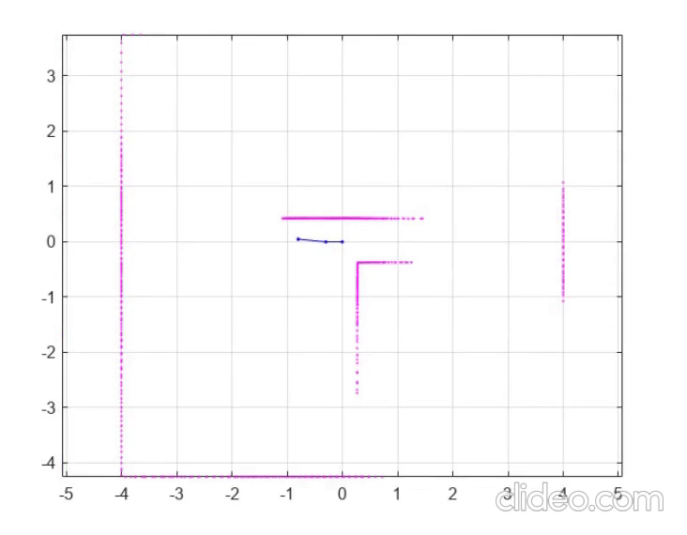
Results
Performing and Optimization
16/18

Slide 18
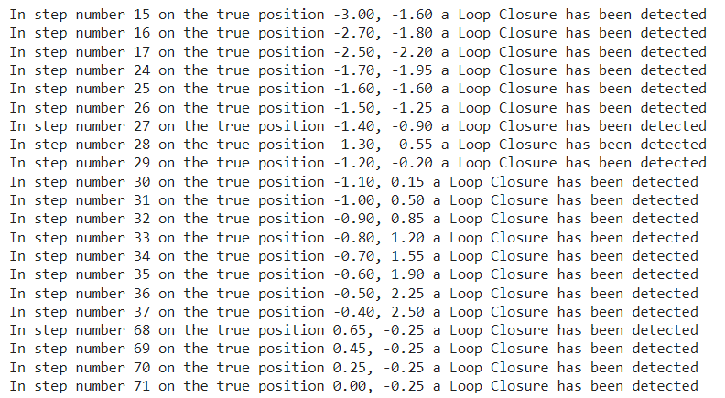
Results
Steps and true positions with closure loop
17/18

Slide 19
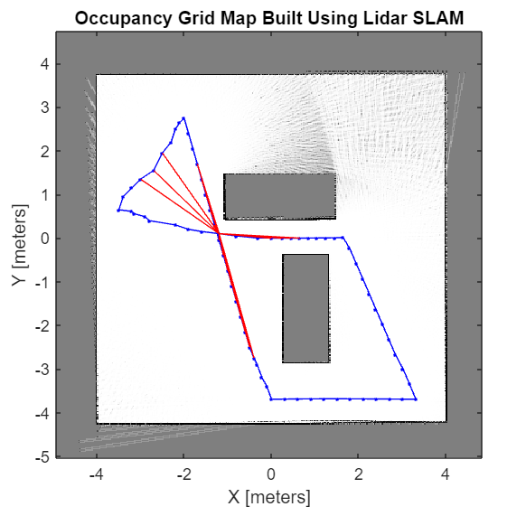
Results
Occupancy grid map
18/18

Slide 20

Thanks for your attention

